Slide 1

Customer Behavior Analysis — Project Overview
This project, customer_behavior_analysis, presents a full data analytics pipeline that transforms raw purchase records into actionable business insights. The workflow uses Python (Jupyter Notebook) for cleaning and EDA, PostgreSQL for storage and advanced SQL, and Tableau for interactive visualization. Core goals: reliable data ingestion, rigorous analysis, and dashboards that inform product, marketing, and subscription strategy.

Slide 2

Data Source
Raw CSV of customer purchase behavior served as the sole data source. Key facts: total records = 3,900 and, after cleaning, the dataset contains 19 columns. The file captured demographic, product, transaction, discount, shipping, rating, and subscription fields necessary for segmentation and revenue analysis.

Slide 3

Data Cleaning & Exploratory Data Analysis (Jupyter)
Performed cleaning and EDA in Python using a Jupyter Notebook. Operations included removing null values (dataset contained no missing values), normalizing column names to lowercase, replacing spaces with underscores, removing special characters, and renaming purchase_amount_usd to purchase_amount. Verified types and distributions using df.info() and df.describe() to ensure consistency before loading to the database.

Slide 4

Database Integration (PostgreSQL)
Connected to PostgreSQL via SQLAlchemy and psycopg2. The cleaned DataFrame was loaded into the public.customer table. Load metrics: total rows inserted = 3,900. The relational schema supports SQL analysis for aggregates, joins, segmentation, and persistence for downstream BI tools like Tableau.

Slide 5
SQL Analysis — Key Queries
Total revenue by gender
High spenders using discounts
Top 5 products by average review rating
Average purchase by shipping type
Aggregate revenue segmented by customer gender to reveal contribution and purchasing patterns.
Identified customers with large purchase totals who still use discounts — useful for targeted offers.
Rank products by mean ratings to inform merchandising and promotions.
Compared AOV across shipping methods to evaluate fulfillment strategy.

Slide 6

Predictive & Cohort Insights
1
2
Subscription likelihood of repeat buyers
Revenue contribution by age group
Estimated probability that repeat purchasers will subscribe, supporting targeted acquisition campaigns.
Quantified which age cohorts contribute most to revenue to guide ad targeting and creative.

Slide 7
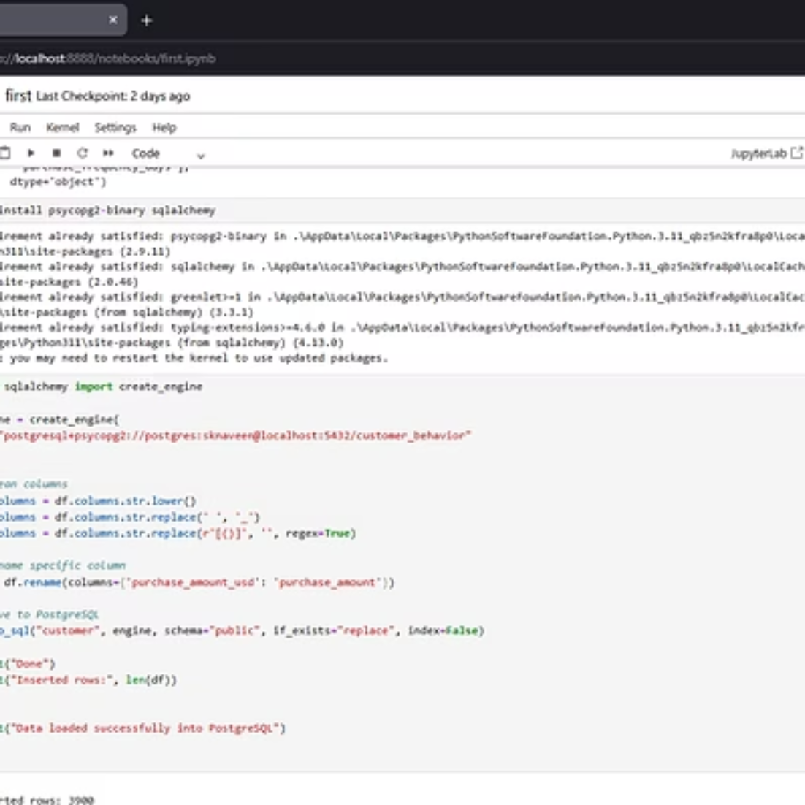
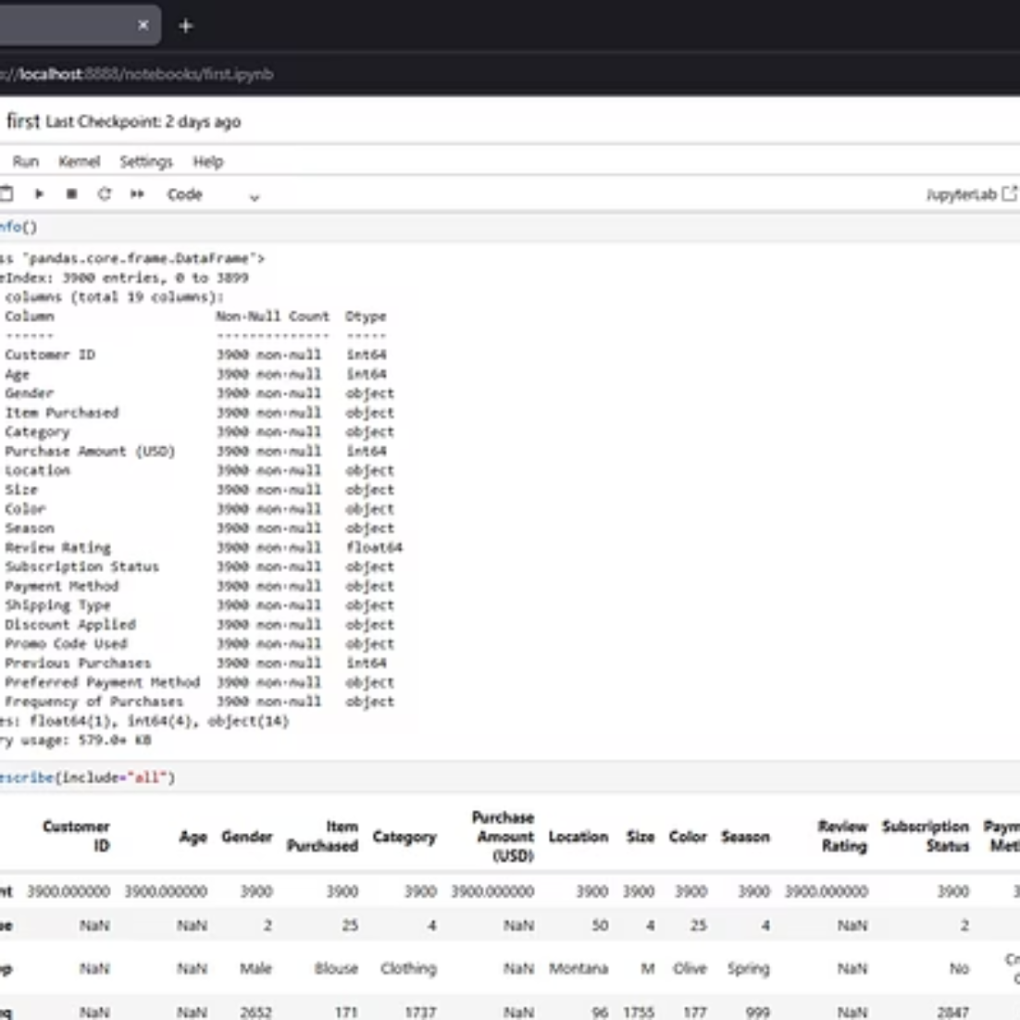
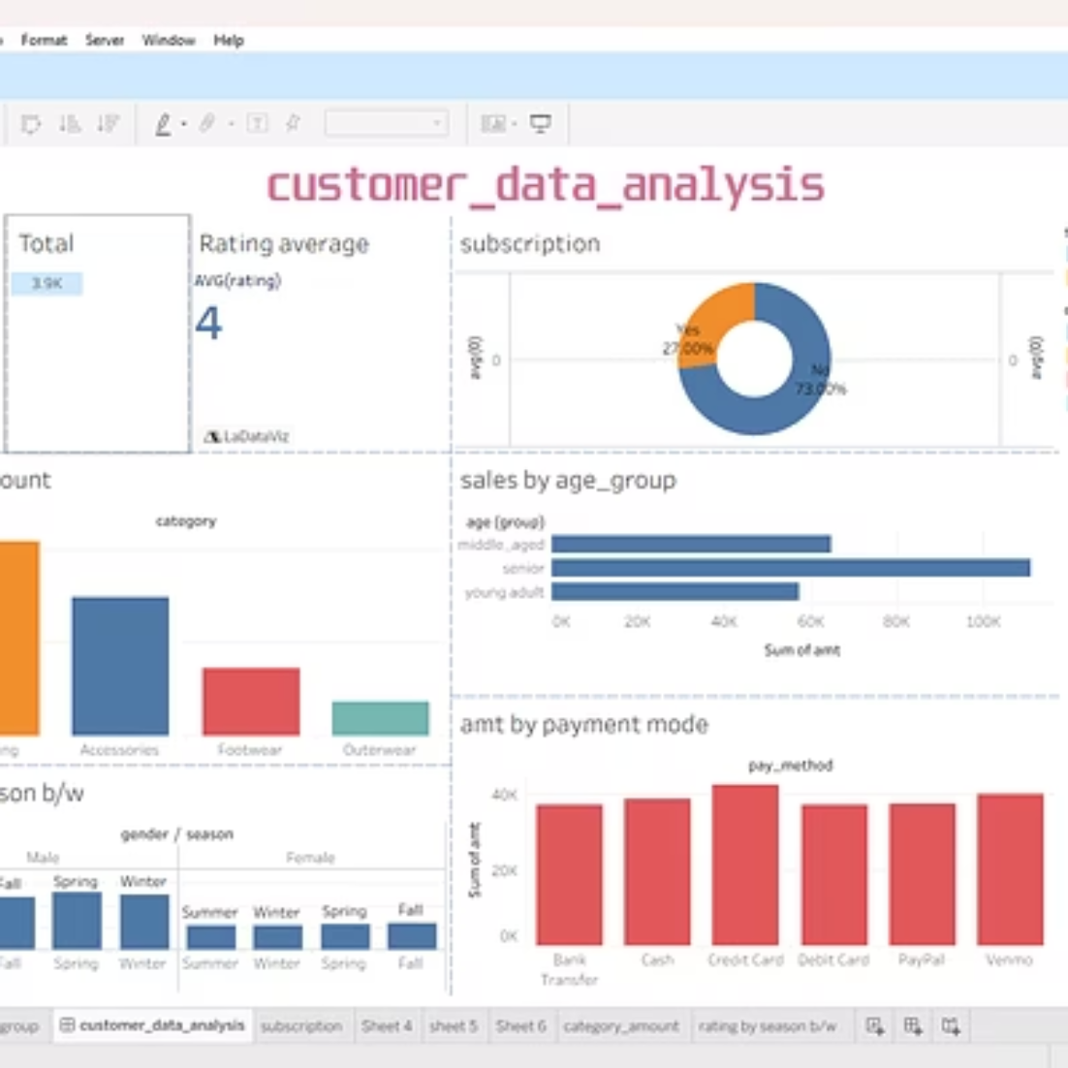
Tableau Visualizations & Dashboard
Built an interactive Tableau dashboard to surface core KPIs and allow exploration by product, segment, and time. Dashboard elements include average sales, total transactions, subscription distribution, sales by category, sales by age group, payment mode analysis, and ratings by season and gender—all designed for rapid stakeholder decision-making.

Slide 8

Visual Evidence & Dashboard Details
The included screenshots show interactive charts and filters used in Tableau: time-series for average sales, bar charts for sales by category and age group, segmented pie/donut for subscription distribution, and season/gender breakdowns for product ratings. These visual artifacts prove the analyses and make insights explorable for business users.

Slide 9
Conclusion & Business Impact
This project demonstrates a complete analytics lifecycle: ingestion of 3,900 raw records, deterministic cleaning to 19 columns, persistence in PostgreSQL, comprehensive SQL analysis (revenue, segmentation, product rankings, subscription propensity), and an interactive Tableau dashboard. The integration of Python, PostgreSQL, and Tableau enables scalable analysis and effective decision support for merchandising, marketing, and subscription growth.
Actionable Outcomes
Next Steps
Targeted campaigns for high-value segments, data-driven promo strategies, and prioritized product investments.
Operationalize subscription propensity model, schedule weekly dashboard refreshes, and expand tracking for LTV modeling.

